Slide 1

Google Ads Data
Analysis Report

Slide 2
Total Spends & Returns by week on week
week | Total Spends | Total Returns | Total Payments
01-Feb | 192.58 | 0
01-Mar | 141.4 | 23.18977757 | 980
03-May | 229.37 | 18.09320743 | 1188
05-Apr | 176.96 | 0
08-Feb | 216.13 | 81.32780083 | 980
08-Mar | 258.2 | 0
12-Apr | 137.21 | 121.5885947 | 2388
15-Feb | 235.3 | 111.9599249 | 1788
15-Mar | 184.36 | 0
19-Apr | 87.38 | 0
22-Feb | 190.9 | 0
22-Mar | 308.73 | 47.61714855 | 2388
25-Jan | 154.79 | 51.89139367 | 2168
26-Apr | 103.26 | 0
29-Mar | 172.11 | 0
Grand Total | 2788.68 | 455.6678476 | 11880
2 nd week of April has the highest spends and returns by week on week
Total spends are 137.21
Total Returns are 121.58

Slide 3
Total Spends & Returns by Month on Month
Month | Total Spends | Total Returns | Total Payments
Jan | 154.79 | 51.89139367 | 2168
Feb | 834.91 | 193.2877257 | 2768
Mar | 1064.8 | 70.80692612 | 3368
Apr | 504.81 | 121.5885947 | 2388
May | 229.37 | 18.09320743 | 1188
Grand Total | 2788.68 | 455.6678476 | 11880
The month of March has the highest spends
Total spends are 834.91
The month of February has the highest returns
Total returns are 193.2

Slide 4
Most Profitable Channel by Campaign
Campaign | Total Profit
EK_Generic_Tri-Tok_Reservation | 3740.43
EK_Generic_Swimming | 2626.74
EK_Generic_Quad-Tok_Yoga | 1345.14
EK_Generic_Tri-Tok_Yoga | 1031.54
EK_Generic_Swimming_UK | 884.79
EK_Generic_Tri-Tok_Yoga_Singapore | 0
EK_Generic_Tri-Tok_Reservation_UAE | -5.21
EK_Generic_Quad-Tok_Yoga_Singapore | -6.38
EK_Generic_Tri-Tok_Reservation_Singapore | -11.33
EK_Generic_Swimming_Canada | -19.71
EK_Generic_Swimming_Singapore | -29.91
EK_Generic_Tri-Tok_Pilates | -39.16
EK_Generic_Quad-Tok_Pilates | -100.88
EK_Generic_Tri-Tok_Reservation_Canada | -158.72
EK_Generic_Tri-Tok_Reservation_UK | -166.02
Grand Total | 9091.32
EK_Generic_Tri-Tok_Reservation is the most profitable channel by Campaign
The total profit is 3740.43

Slide 5
Most Profitable channel by Ad group
Ad Group | Total Profit
Pool_Reservation_Software_Broad | 3060.52
Reservation_Management_System_Exact | 1731.85
Reservation_Management_System_Phrase | 1667.3
Yoga_Studio_Booking_Software_Broad | 1377.83
Yoga_Studio_Software_Phrase | 1122.34
Pool_Reservation_System_Exact | 739.28
Pilates_Studio_Management_Software_Exact | 0
Yoga_Studio_Generic_Software_Phrase | 0
Pilates_Studio_Software_Phrase | 0
Pilates_Studio_Software_Manager_Exact | 0
Pilates_Booking_System_Phrase | 0
Pilates_Management_Software_Exact | 0
Pilates_Booking_System_Exact | 0
(blank)
Yoga_Studio_Software_Broad | -4.62
Yoga_Studio_App_Phrase | -10.63
Swimming_Pool_Reservation_System_Exact | -19.65
Yoga_Studio_App_Exact | -22.29
Yoga_Studio_Software_Exact | -23.06
Pool_Reservation_Software_Exact | -26.45
Yoga_Studio_App_Broad | -30.2
Pool_Reservation_Software_Open_Broad | -31.45
Yoga_Studio_Booking_Software_Exact | -39.07
Pilates_Studio_Software_Exact | -39.16
Swimming_Pool_Booking_System_Exact | -39.66
Pool_Booking_App_Exact | -74.12
Pilates_Studio_Booking_Software_Broad | -100.88
Pool_Scheduling_Software_Phrase | -146.56
Grand Total | 9091.32
Pool_Reservation_Software_Broad is the most profitable channel by Ad group
The profit is 3060.52

Slide 6
Profit by Keywords
Keywords | Total Profit
Exact | 2187.67
Phrase | 2632.45
Broad | 4271.2
Grand Total | 9091.32
The Keyword Board has the highest profit
The profit is 4271.2

Slide 7
Time series Graph on week on week
week payment | Total Spends | Total payments | Total Returns
00-01-00 | 2499.49 |  | 0
01-03-21 | 15.97 | 1788 | 111.9599249
01-05-21 | 19.64 | 2388 | 121.5885947
03-02-21 | 38.33 | 980 | 25.56744065
03-04-21 | 50.15 | 2388 | 47.61714855
04-05-21 | 65.66 | 1188 | 18.09320743
13-03-21 | 45.13 | 1188 | 26.32395302
15-02-21 | 12.05 | 980 | 81.32780083
29-04-21 | 42.26 | 980 | 23.18977757
Grand Total | 2788.68 | 11880 | 455.6678476
1 st week of January has the highest spends in the week on week
Total spends are 2499.49
1 st week of May has the highest returns in the week on week
Total Returns are 121.5

Slide 8
Time series Graph on week on week
month payment | Total Spends | Total payments | Total Returns
01-00 | 2499.49 |  | 0
02-21 | 50.38 | 1960 | 106.8952415
03-21 | 61.1 | 2976 | 138.2838779
04-21 | 92.41 | 3368 | 70.80692612
05-21 | 85.3 | 3576 | 139.6818021
Grand Total | 2788.68 | 11880 | 455.6678476
The month of January has the highest spends in the month on month
Total spends are 2499.49
1 st week of May has the highest returns in the week on week
Total Returns are 139

Slide 9
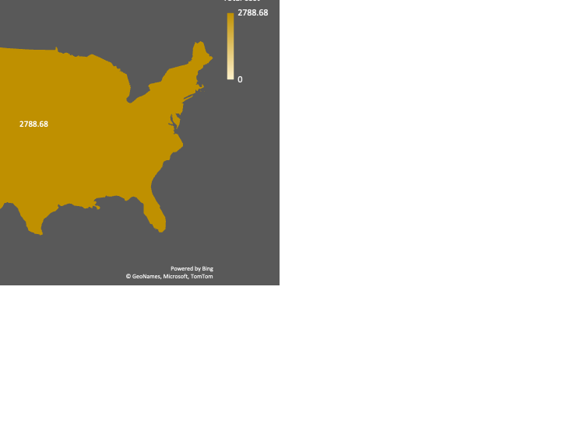
Total spends by country
Campaign | Total Spends | Total Returns
USA | 2788.68 | 455.6678476
EK_Generic_Quad-Tok_Pilates | 100.88 | 0
EK_Generic_Quad-Tok_Yoga | 822.86 | 49.51373059
EK_Generic_Quad-Tok_Yoga_Singapore | 6.38 | 0
EK_Generic_Swimming | 741.26 | 73.1845892
EK_Generic_Swimming_Canada | 19.71 | 0
EK_Generic_Swimming_Singapore | 29.91 | 0
EK_Generic_Swimming_UK | 95.21 | 81.32780083
EK_Generic_Tri-Tok_Pilates | 39.16 | 0
EK_Generic_Tri-Tok_Reservation | 435.57 | 233.5485196
EK_Generic_Tri-Tok_Reservation_Canada | 158.72 | 0
EK_Generic_Tri-Tok_Reservation_Singapore | 11.33 | 0
EK_Generic_Tri-Tok_Reservation_UAE | 5.21 | 0
EK_Generic_Tri-Tok_Reservation_UK | 166.02 | 0
EK_Generic_Tri-Tok_Yoga | 156.46 | 18.09320743
EK_Generic_Tri-Tok_Yoga_Singapore | 0 | 0
Grand Total | 2788.68 | 455.6678476
The total spends by country in the U.S.A is 2788.68

Slide 10
